Slide 1
Ethics Week 6 – BIG QUESTIONS AROUND THE CMA
Andrew Peck

Slide 2

Hands Up (Week 6)
I engage with my subject outside of the classroom
I think update training and exposure is important
Our experiences and interactions shape us
I have strong case-studies I can talk about with peers

Slide 3
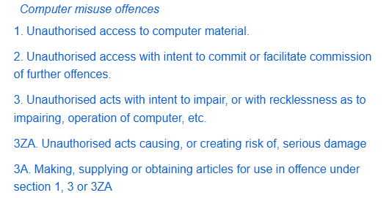
The Computer Misuse Act
https://www.legislation.gov.uk/ukpga/1990/18/contents

Slide 4
Read
Guinchard, A., 2018. The Computer Misuse Act 1990 to support vulnerability research? Proposal for a defence for hacking as a strategy in the fight against cybercrime. Journal of Information Rights, Policy and Practice, 2(2).
Crawford, J., 2021. The Computer Misuse Act and Hackers: A review of those convicted under the Act. Inf. Secur. Group, Roy. Holloway Univ. London, Egham, UK, Tech. Rep.
Montasari, R., Peltola, P. and Carpenter, V., 2016, June. Gauging the effectiveness of computer misuse act in dealing with cybercrimes. In 2016 International Conference On Cyber Security And Protection Of Digital Services (Cyber Security) (pp. 1-5). IEEE.

Slide 5
Present
5 minute presentation about the article you have read:
Its core arguments
Do you agree or not?
What does this mean for you as a professional?
(3 slides)

Slide 6
AI Confidential
Critically watch:
3 stakeholders:
Police
Public
Developer
Notes:
https://www.bbc.co.uk/iplayer/episode/m002q76d/ai-confidential-with-hannah-fry-series-1-1-the-boy-who-tried-to-kill-the-queen

Slide 7
Reflection
Suggest updates to the computer misuse act to respond to: https://www.theguardian.com/technology/ng-interactive/2026/mar/12/lab-test-mounting-concern-over-rogue-ai-agents-artificial-intelligence

Slide 8
Any Questions?
Any Questions

Slide 9
Other Approaches
Oxford (algorithms):
Radanliev, P., De Roure, D., & Santos, O. (2023). Red Teaming Generative AI/NLP, the BB84 quantum cryptography protocol and the NIST-approved Quantum-Resistant Cryptographic Algorithms. arXiv preprint arXiv:2310.04425.
Worth a read, but no supply chain issues or challenges to wider implementation (possibly due to reliance on expertise)
Hardware approaches:
Pagliarini, S., Aikata, A., Imran, M., & Sinha Roy, S. (2024, July). REPQC: Reverse Engineering and Backdooring Hardware Accelerators for Post-quantum Cryptography. In Proceedings of the 19th ACM Asia Conference on Computer and Communications Security (pp. 533-547).
Taxonomy
Blakely, B., Chung, J., Poczatek, A., Syed, R., & Kettimuthu, R. (2024). Toward a Quantum Information System Cybersecurity Taxonomy and Testbed: Exploiting a Unique Opportunity for Early Impact. arXiv preprint arXiv:2404.12465.

